Slide 1
The Constitution: Explained!
7th Grade Social Studies

Slide 2
The Preamble
The Preamble outlines the purpose of why the Constitution is needed.
The document that was in place before the Constitution was called The Articles of Confederation.
The Articles of Confederation were too weak - the government had very little power
Some people said they rather have “a rope of sand” for a document than “an iron rod”
The Constitution was the perfect compromise.

Slide 3
The preamble
We the People of the United States, in Order to form a more perfect Union, establish Justice, insure domestic Tranquility, provide for the common defense, promote the general Welfare, and secure the Blessings of Liberty to ourselves and our Posterity, do ordain and establish this Constitution for the United States of America.
Can you memorize and recite this for extra credit???

Slide 4
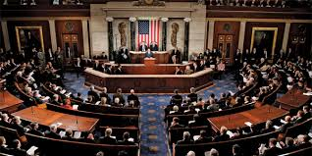
Article One: The Congress
SECTION ONE: A BICAMERAL CONGRESS
Congress is made up of two houses - The House of Representatives and The Senate

Slide 5
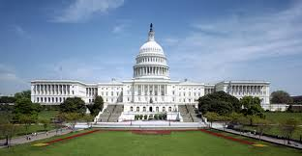
Article One: The Congress
SECTION TWO: THE HOUSE OF REPRESENTATIVES
Elections for the House of Representatives occur every two years
The number of representatives each state receives is based on the state’s population

Slide 6
Article One: The Congress
SECTION TWO: THE HOUSE OF REPRESENTATIVES
A representative must be at least 25 years old, must have been a U.S. citizen for at least 7 years, and must, at the time of election, be a citizen of the state from which he is elected.
The power of impeachment resides in the House.

Slide 7
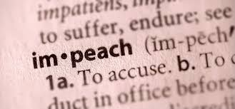
Impeachment
Impeachment means that a charge of misconduct is filed against the president

Slide 8
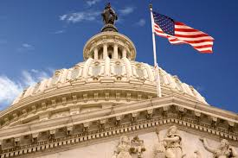
Article One: The Congress
SECTION THREE: THE SENATE
Each state has two senators
Senators are elected every six years
A senator must be at least 30 years old, must have been a U.S. citizen for at least 9 years, and must, at the time of election, be a citizen of the state from which he is elected

Slide 9
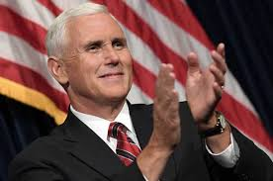
Article One: The Congress
SECTION THREE: THE SENATE
The vice president of the United States serves as president of the Senate, but will not be allowed to vote except to break a tie.
The Senate tries all cases of impeachment. The chief justice presides over presidential impeachment trials. A conviction requires that 2/3 of the members present agree. The Senate can only remove a convicted official from office and disqualify him from holding other federal offices.

Slide 10
Article One: Congress
SECTION SIX: SALARIES, PRIVILEGES, AND CONSTRAINTS FOR MEMBERS OF CONGRESS
Congress’s salaries are to be determined by law.
Senators and representatives cannot be arrested for a crime, except for treason, felony, or breach of peace, while meeting in Congress or while traveling to or from a meeting of Congress.

Slide 11
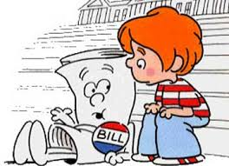
Article one: Congress
SECTION SEVEN: HOW A BILL BECOMES A LAW
A proposed law, or bill, can originate in either the Senate or the House of Representatives, except for new tax laws, which must come from the House of Representatives.
If a bill is passed in both the House and the Senate, it will go to the president for review. The president has the right to accept it or return it with objections to the house that had originally proposed it.

Slide 12
Article one: Congress
SECTION SEVEN: HOW A BILL BECOMES A LAW
If 2/3 of that house agrees to pass the bill, it is sent to the other house for reconsideration. If 2/3 of the other house also agrees to pass the bill, it automatically becomes a law despite the president’s veto.

Slide 13
Article one: Congress
SECTION SEVEN: HOW A BILL BECOMES A LAW
If the president takes more than 10 days to return a bill, not counting Sundays, the bill automatically becomes a law unless Congress has already ended its session. [Note: If Congress has indeed ended its session within this 10-day period, the bill dies in what is known as a “pocket veto” —so named because the president has effectively killed the bill by not responding, or by pocketing it.]

Slide 14
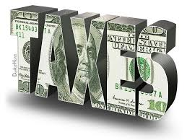
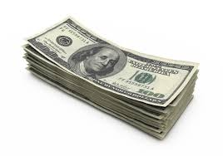
Article one: Congress
SECTION EIGHT: POWERS GIVEN TO CONGRESS
Congress has the power to levy and collect taxes
Congress has the power to coin money and establish its value relative to foreign currency
Congress declares war

Slide 15
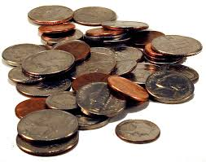
ARTICLE ONE: CONGRESS
SECTION TEN: POWERS WITHHELD FROM THE STATES
States are forbidden to enter into any treaties or alliances
States are also forbidden to coin money or print paper money

Slide 16
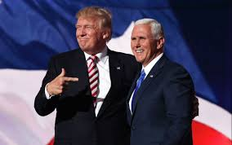
Article two: the executive branch
SECTION ONE: QUALIFICATIONS FOR THE PRESIDENT AND VICE PRESIDENT
The executive branch of the U.S. government includes a president and a vice president, who serve together for a term of 4 years.
The president and vice president are elected by a number of electors.

Slide 17
Article two: the executive branch
SECTION ONE: QUALIFICATIONS FOR THE PRESIDENT AND VICE PRESIDENT
The president must be a natural-born citizen. The president must be at least 35 years old and must have lived in the United States for at least 14 years.

Slide 18
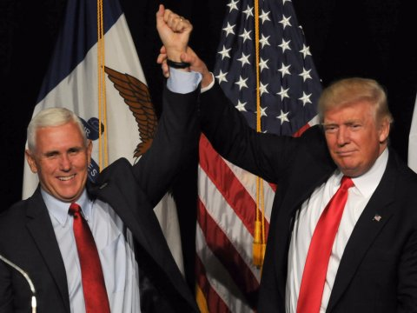
Article two: the executive branch
SECTION ONE: QUALIFICATIONS FOR THE PRESIDENT AND VICE PRESIDENT
If the president dies, is removed from office, resigns, or is otherwise unable to discharge the powers of his office, the vice president will assume the presidential duties.

Slide 19
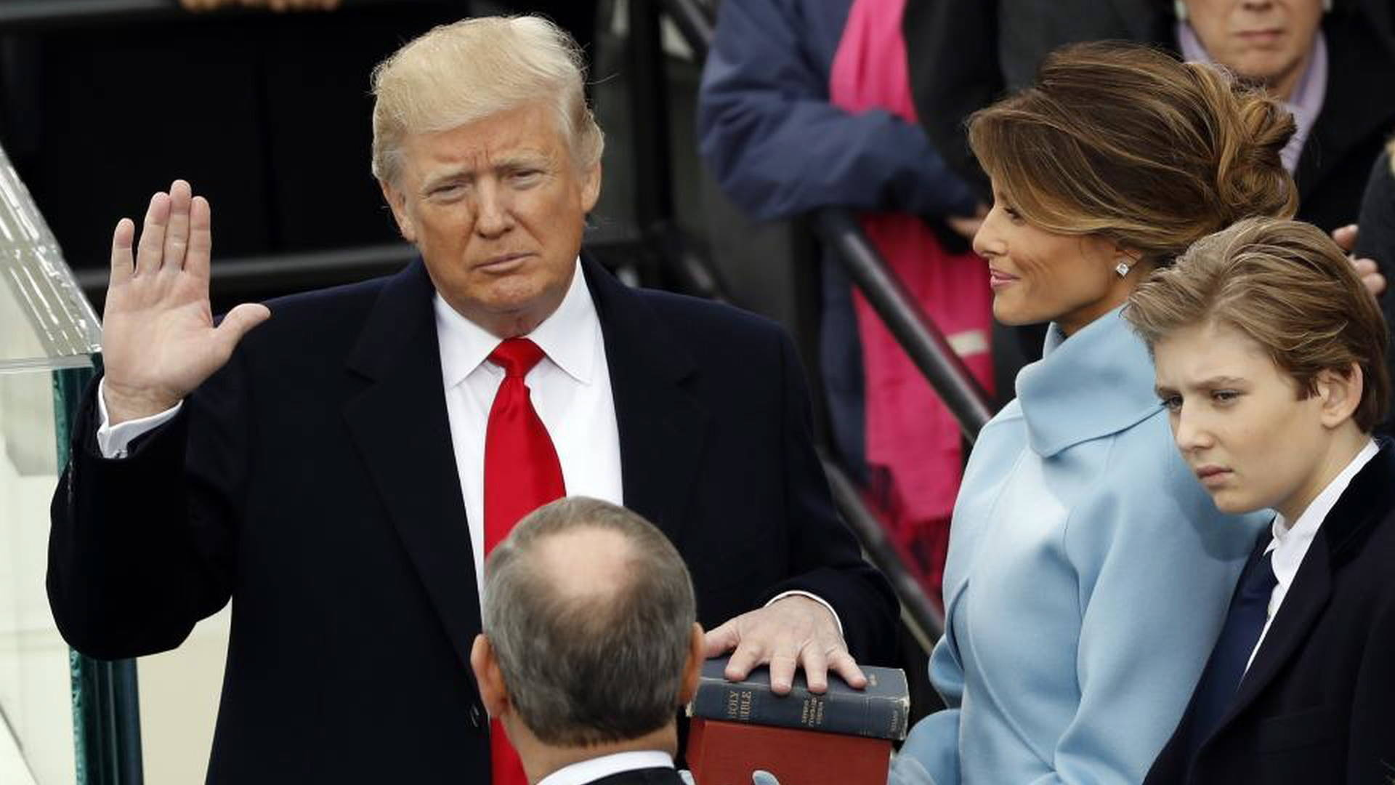
Article two: the executive branch
SECTION ONE: QUALIFICATIONS FOR THE PRESIDENT AND VICE PRESIDENT
The president takes the following oath before he officially has the power of the presidency:
"I do solemnly swear (or affirm) that I will faithfully execute the Office of the President of the United States, and will to the best of my ability, preserve, protect and defend the Constitution of the United States."

Slide 20
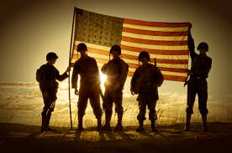
Article two: the executive branch
SECTION TWO: PRESIDENTIAL POWERS
The president serves as the commander-in-chief of both the army and navy of the United States and of the militia in each state when used for national purposes.
The president may request, in writing, the advice of the highest officer in each executive department

Slide 21
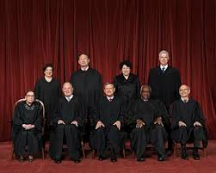
Article two: the executive branch
SECTION TWO: PRESIDENTIAL POWERS
The president has the authority to grant pardons in all cases except impeachments.
The president has the power to nominate Supreme Court justices

Slide 22
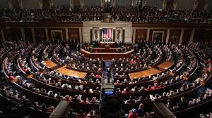
Article two: the executive branch
SECTION THREE: PRESIDENTIAL DUTIES
The president must occasionally give a speech to Congress on the “State of the Union” and recommend to Congress actions that he deems necessary.
The president ensures that all laws are executed and commissions all the officers of the United States.

Slide 23
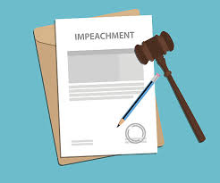
ARTICLE TWO: THE EXECUTIVE BRANCH
SECTION FOUR: IMPEACHMENT
The president, vice president, and any other civil officers can be impeached and then removed from office if convicted of treason, bribery, or other high crimes and misdemeanors.

Slide 24
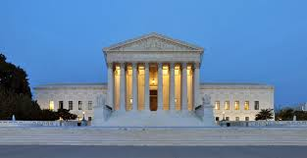
ARTICLE THREE: THE JUDICIARY
SECTION ONE: THE FEDERAL COURT SYSTEM
The judicial branch of the U.S. government is made up of one Supreme Court and whatever inferior courts that Congress establishes by law.
Judges in all courts will keep their positions so long as they maintain good behavior. Judges receive a salary for their job that cannot be reduced during their entire time in office.

Slide 25
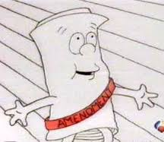
ARTICLE FIVE: THE AMENDMENT PROCESS
Amendments to the U.S. Constitution can be proposed either:
if 2/3 of both the Senate and House of Representatives agree
if 2/3 of all state legislatures call a convention for proposing new amendments

Slide 26
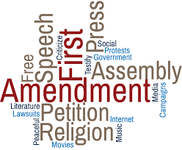
THE BILL OF RIGHTS: THE FIRST TEN AMENDMENTS
First Amendment
This amendment guarantees freedom of religion, speech, and the press, and protects the right of assembly.

Slide 27
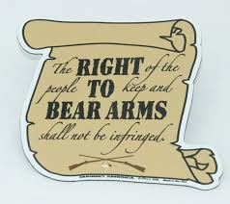
THE BILL OF RIGHTS: THE FIRST TEN AMENDMENTS
Second Amendment
This amendment protects the right to keep and bear arms.

Slide 28
THE BILL OF RIGHTS: THE FIRST TEN AMENDMENTS
Third Amendment
This amendment guards against the forced quartering of troops. (In the years before the American Revolution, British officials forced the colonists to quarter—to house and feed—British troops.)

Slide 29
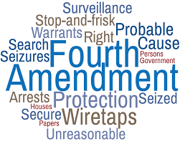
THE BILL OF RIGHTS: THE FIRST TEN AMENDMENTS
Fourth Amendment
This amendment protects against unreasonable searches and seizures.

Slide 30
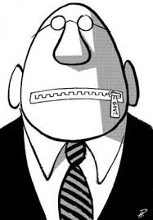
THE BILL OF RIGHTS: THE FIRST TEN AMENDMENTS
Fifth Amendment
This amendment guarantees a trial by jury and “due process of law,” and guards against double jeopardy (being charged twice for the same offense) and self-incrimination.

Slide 31
THE BILL OF RIGHTS: THE FIRST TEN AMENDMENTS
Sixth Amendment
This amendment outlines the rights of the accused, including the right to have a "speedy and public" trial, the right to be informed of the charges made against him, the right to call witnesses in his defense, and the right to have an attorney in his defense.

Slide 32
THE BILL OF RIGHTS: THE FIRST TEN AMENDMENTS
Seventh Amendment
This amendment lays out the rules of common law.
(Guarantees a jury trial for both civil and federal cases if the dispute is more than $20)

Slide 33
THE BILL OF RIGHTS: THE FIRST TEN AMENDMENTS
Eighth Amendment
This amendment protects against “cruel and unusual punishments.”

Slide 34
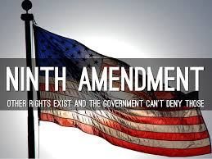
THE BILL OF RIGHTS: THE FIRST TEN AMENDMENTS
Ninth Amendment
This amendment ensures that the individual rights that are not enumerated in the Constitution are secure—that is, that these rights should not be automatically infringed upon because they are omitted from the Constitution.
(There are other rights that are not listed but are still protected)

Slide 35
THE BILL OF RIGHTS: THE FIRST TEN AMENDMENTS
Tenth Amendment
This amendment limits the power of federal government by reserving for the states all powers that are not explicitly granted to the federal government by the Constitution, nor denied to the states.

Slide 36
Bill of rights hand gestures

Slide 37
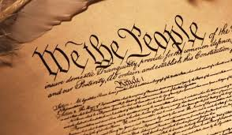
Other amendments worth noting
Thirteenth Amendment (Ratified in 1865)
This amendment abolishes slavery.
Fourteenth Amendment (Ratified in 1868)
This amendment protects the rights of U.S. citizenship.
Fifteenth Amendment (Ratified in 1870)
This amendment guarantees the right to vote to all male citizens regardless of race, color, or previous condition of servitude.

Slide 38
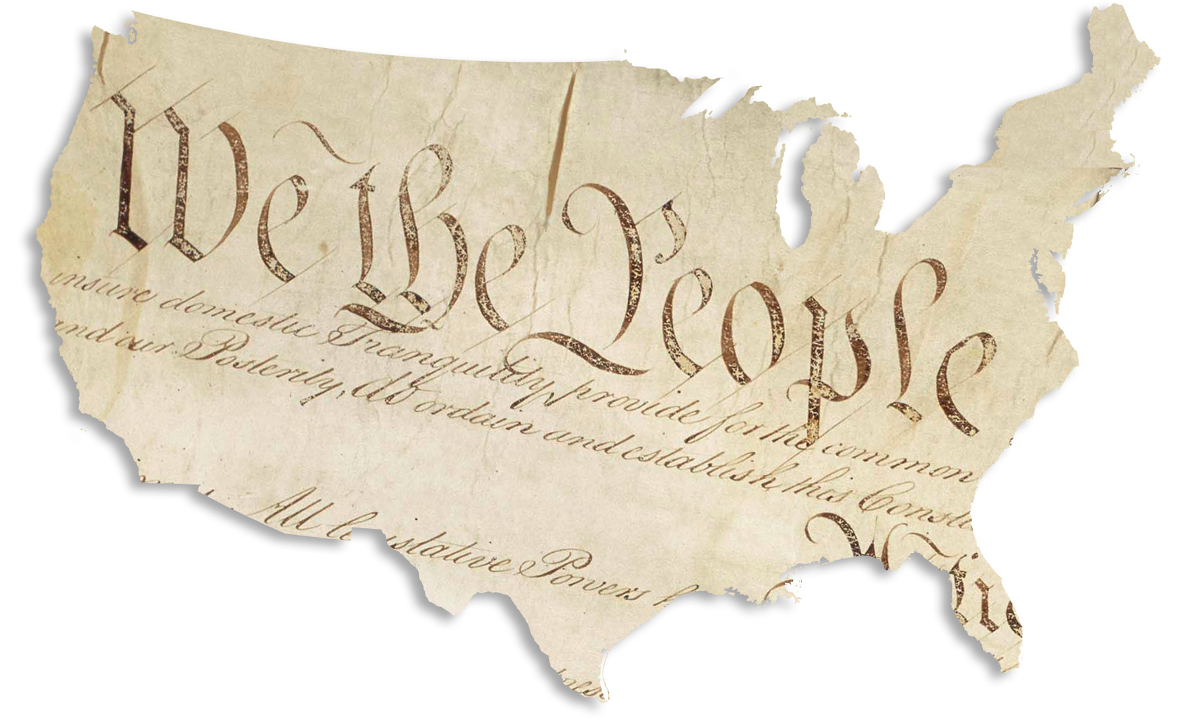
Other amendments worth noting
Eighteenth Amendment (Ratified in 1919/Repealed in 1933)
This amendment prohibits the manufacture, transport, and sale of alcohol one year after the amendment’s ratification.
Nineteenth Amendment (Ratified in 1920)
This amendment extends the right to vote to women.

Slide 39
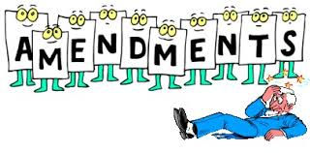
Other amendments worth noting
Twenty-First Amendment (Ratified in 1933)
This amendment repeals the prohibition amendment (the Eighteenth Amendment). It does not, however, infringe upon state prohibition laws.
Twenty-Second Amendment (Ratified in 1951)
This amendment sets a presidential term limit of 2 terms, or 8 years. [Note: In 1796, George Washington retired from office, thereby setting the precedent of presidents serving no more than 2 terms in office. Every president until Franklin Delano Roosevelt followed this precedent.]

Slide 40
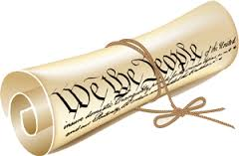
Other amendments worth noting
Twenty-Fourth Amendment (Ratified in 1964)
This amendment prohibits the use of poll taxes to abridge voting rolls. (Poll taxes required that voters pay a tax in order to vote.)
Twenty-Sixth Amendment (Ratified in 1971)
This amendment lowers the voting age to 18. The previous voting age was 21, as set by the Fourteenth Amendment.

